Slide 1
MISSION:
We endeavor to demonstrably improve the health and well-being of rural Ghanaians through compassionate medical care, effective public health education, and collaborative community development initiatives.

Slide 2
REACH 4 Ghana; History
2010: R4G Founded by students in VCUSOM 2014
2011: Inaugural Trip
2011: Board of Directors becomes operational
2012: Became official VCU student organization
2013: Earned 501(c)(3) IRS tax-exempt status

Slide 3
Organizational Structure
Board of Directors
Provides oversight and guidance
Task based sub-committees; quarterly bulletin to current team
Current year’s team
Modeled but (not necessarily) identical to prior rosters
Division of labor via subcommittees
Bon Secours Family Practice (Richmond, VA)
Resident and attending physicians from VCU-associated residency
In-Country Partner- LiliMed, Ho, Ghana
Provides local staff, rapport, and physicians for clinic

Slide 4
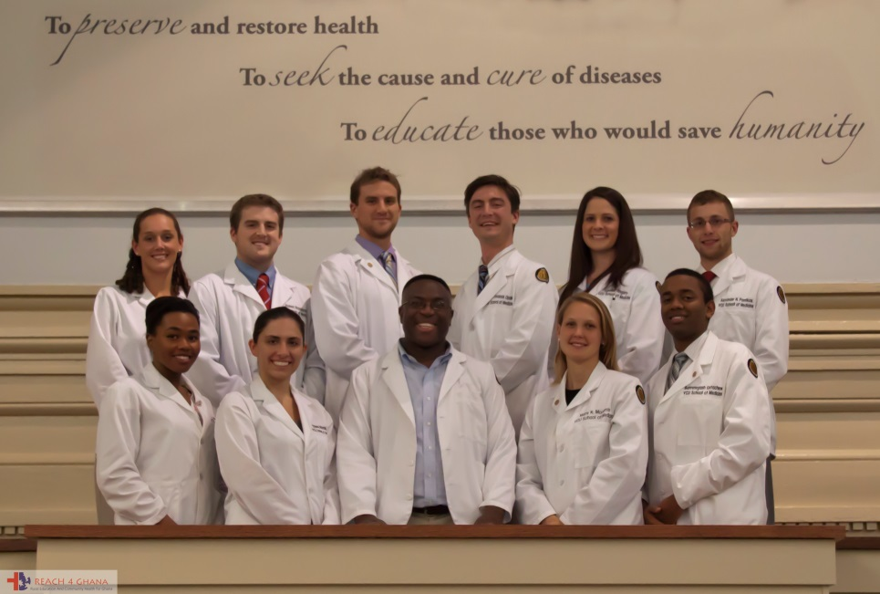
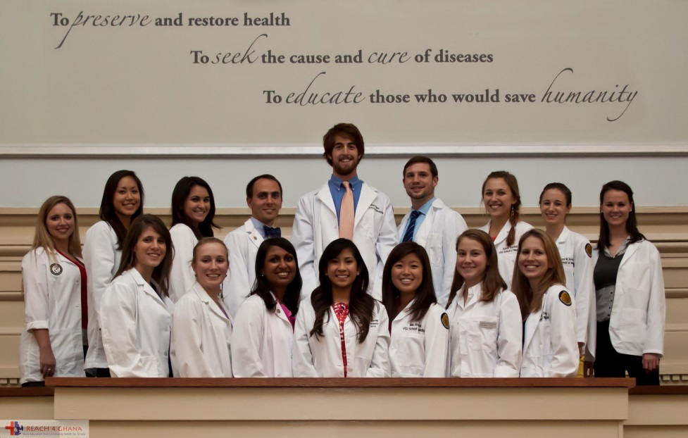
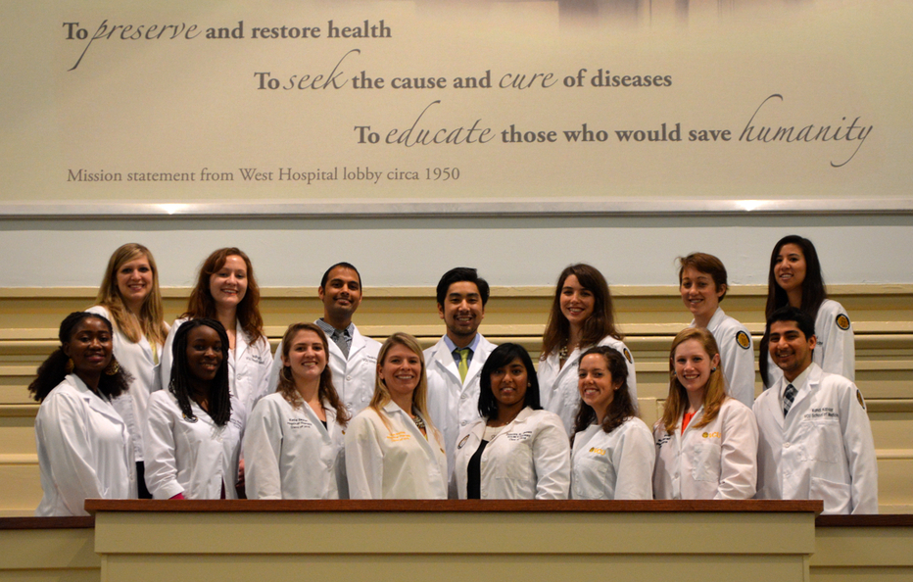
Prior Trips
2011
2012
2013
2014
Notes:
2011: 14 M1s
2012: 10 M1s, 2 M2s, 1 PT, 1 attending
2013: 9 M1s, 1 M2, 5 PTs, 2 Pharm, 5 residents, 1 attending
2014: 11 M1s, 4 PTs, 2 Pharm, 6 residents, 1 attending
Travel to Volta region of Ghana
Same 5 rural villages annually
Team operates out of Ho, district capital
1000s of patients seen, treated, referred

Slide 5
Research Opportunities
2011: Malaria Knowledge, Attitudes, Practices
Poster at CUGH 2013; VCU Global Health Symposium
Insecticidal Net Distribution
2012: Hypertension Knowledge, Attitudes, Practices
Poster at VCU Global Health Symposium
Presentation at AAMC conference
2013: Hypertension Prevalence Study
Poster at VCU Global Health Symposium – Best Research Award
Poster at VCU SOM Student Honors Day
Manuscript currently in progress
2014: CVD Comorbidities and Socioeconomic Status Study

Slide 6
General Trip Info
Timing:
First 2 weeks in June
In-Country Activities:
3-5 villages in Volta Region
Medical clinic and vision/cataract screening
Physical therapy
Develop public health curriculum / public health projects
Teach children and adults
REACH 4 Ghana | PO Box 889, Richmond, VA 23218 | www.reach4ghana.org

Slide 7
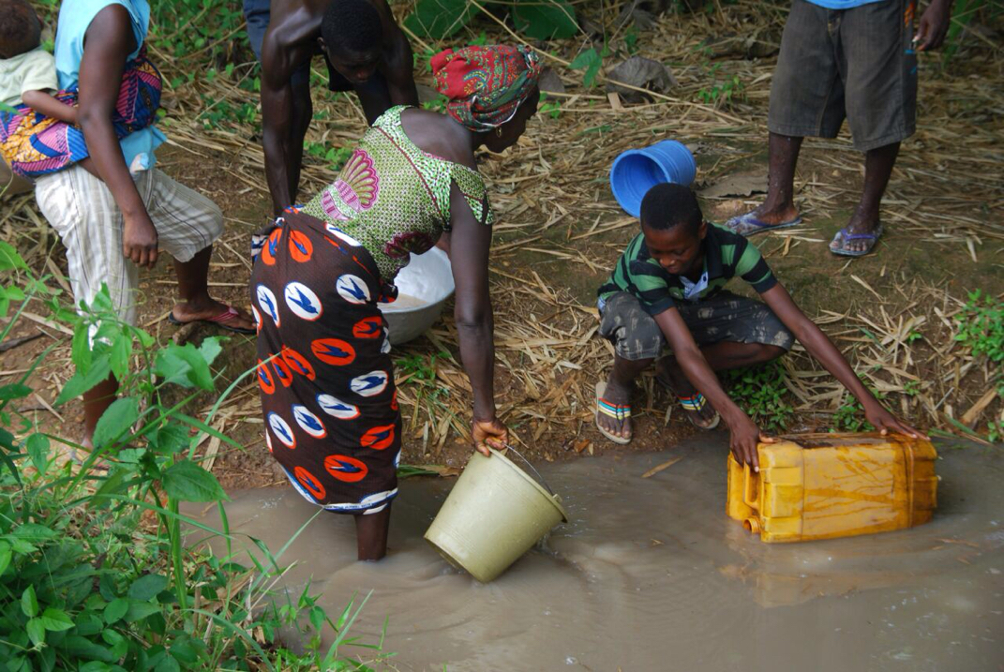
Water Well Project

Slide 8
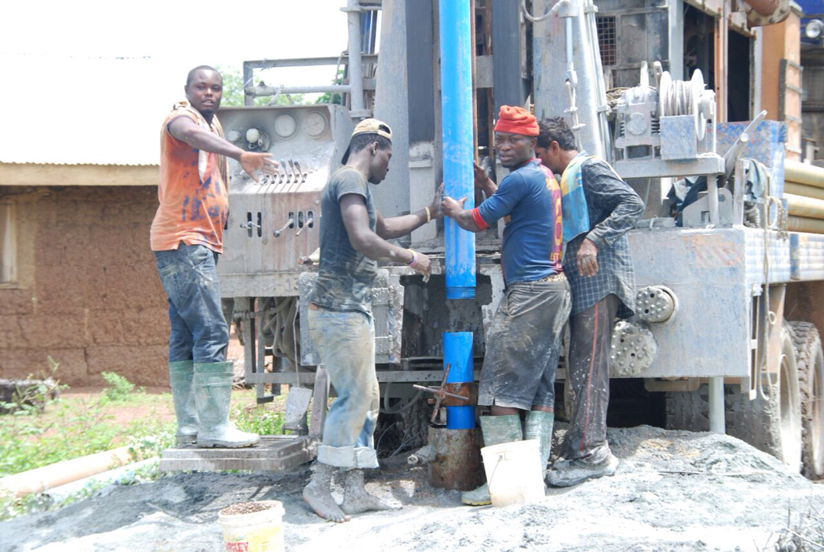
Water Well Project

Slide 9
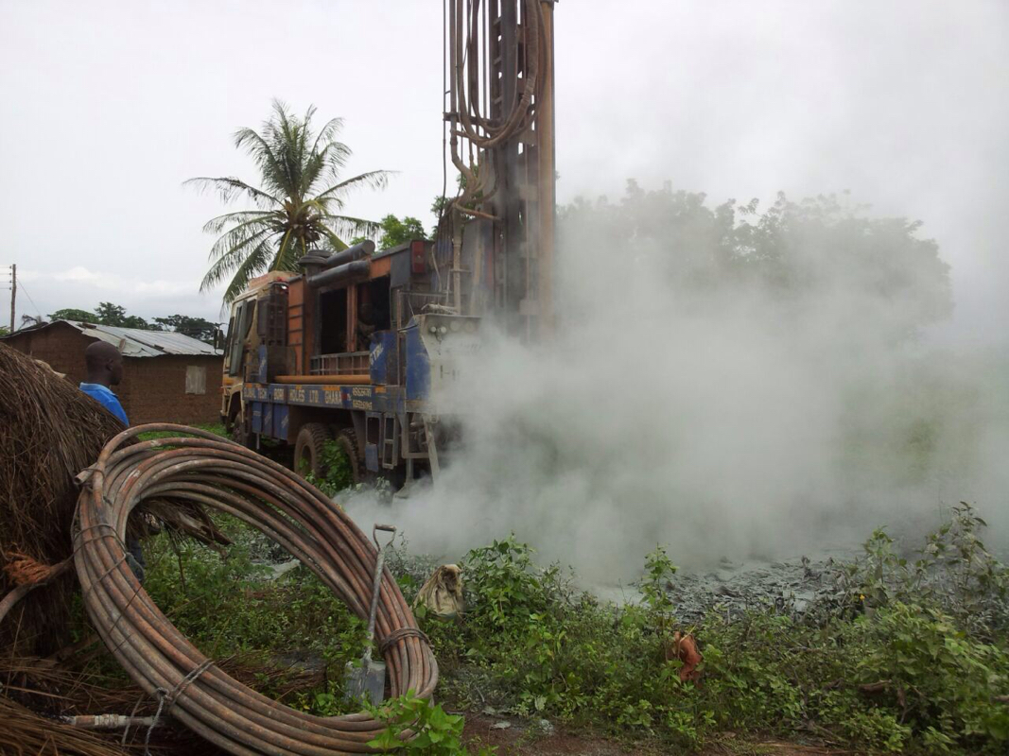
Water Well Project

Slide 10
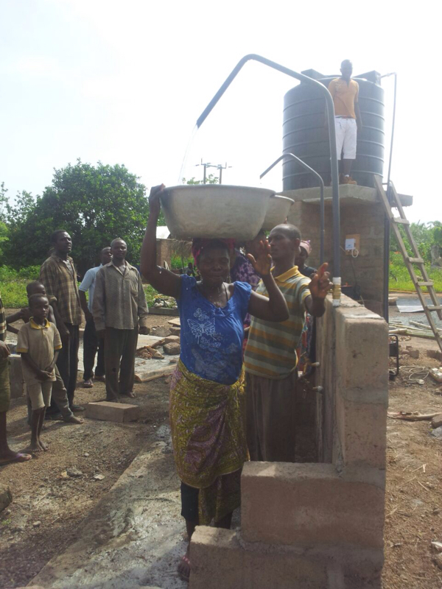

Slide 11
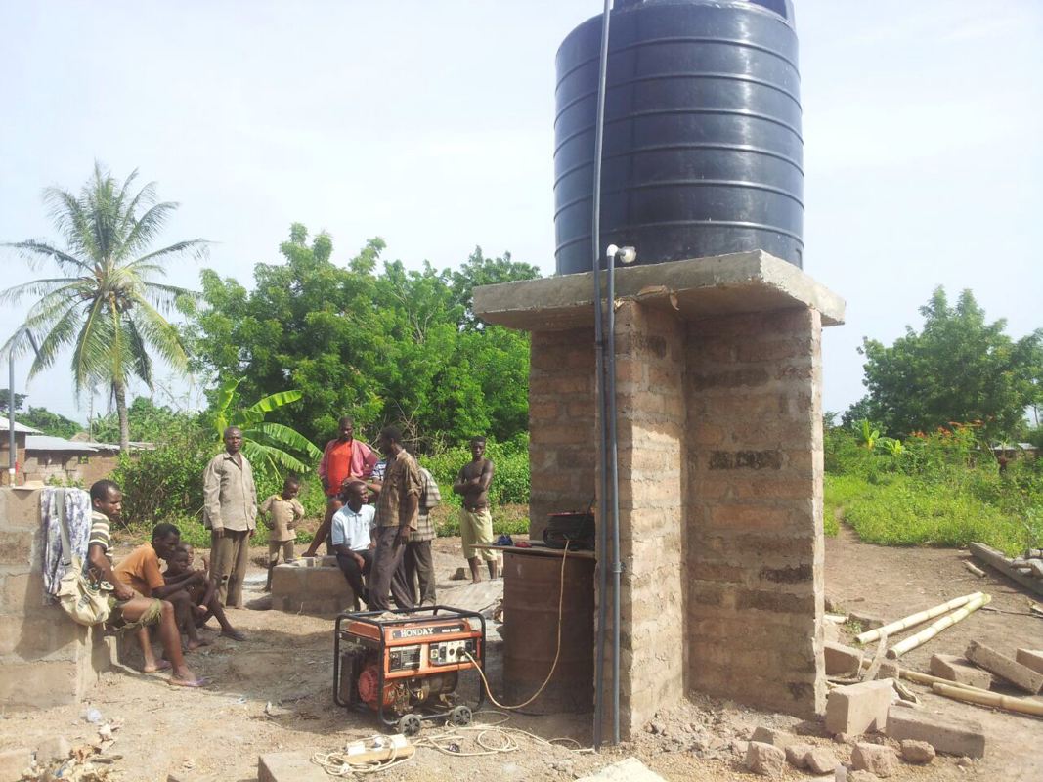
Water Well Project

Slide 12
Costs
These are ESTIMATES and be aware that they can go UP or DOWN
In-country cost $600-700 (ish!)
Includes: food, accommodations, travel, excursions
Airfare $1500
Likely we can find them for less if secured early
Immunizations $0-300, insurance-dependent
Includes: polio, hepatitis A, typhoid fever, yellow fever
Medications/Eyeglasses $150 Total (est.): $2100-2500
**Several people have managed to raise the entire cost of their trip!
REACH 4 Ghana | PO Box 889, Richmond, VA 23218 | www.reach4ghana.org

Slide 13
Time Commitment
Team meetings
Every Other Week (twice a month)
Meetings approx. ~1 hr
Most work done outside of meetings
Team leaders brief the team on updates/logistics
Board member(s) will attend each team meeting
Global Health Elective - Attend 4 Saturdays in the spring
Fundraisers - Planning and hosting, time varies
REACH 4 Ghana | PO Box 889, Richmond, VA 23218 | www.reach4ghana.org

Slide 14
Leadership Positions
Team Leaders
Plan meetings, serve as in-country leaders
Liaisons between team, resident corps, and board members
Secretary
Takes minutes during team meeting; organizes team correspondences
Committee Chairs
Cultural
Finance
Medical
Public Health Education
Research
Board of Directors Membership (post-trip)
REACH 4 Ghana | PO Box 889, Richmond, VA 23218 | www.reach4ghana.org

Slide 15
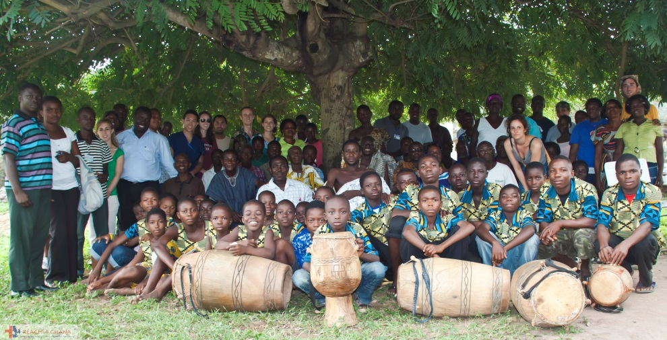
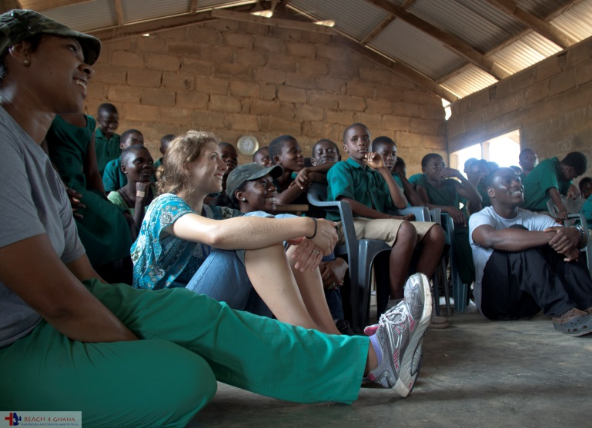
REACH 4 Ghana 2011, 2012, 2013, 2014
Check it out…
www.reach4ghana.org
…for 2016 application, videos, & trip updates, etc.

Slide 16
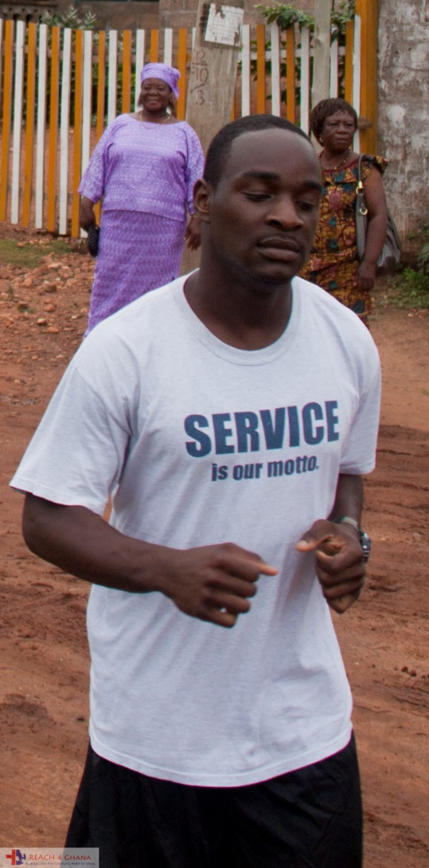
Longitudinal Involvement
Trip Member Opens Door to:
Leadership Opportunity
Research Involvement
Teaching Experience
Public Health Projects
Board Member +/- Officership
M4 Clinical Studies (Int’l Rotation)
Post-Graduate Involvement

Slide 17
Questions?
Ask now
Email
reach4ghana@gmail.com
Approach Previous Teams
Names on website
REACH 4 Ghana | PO Box 889, Richmond, VA 23218 | www.reach4ghana.org

Slide 18
Pertinent Dates
2016 TRIP: Early June (TBD by team & resident schedule)
Clinic (one week)
Education in community schools OR public health projects (one week)
Excursions (weekends)
Programs with city youth (some afternoons/evenings)
Application Dates
Application due: Mid-August (date TBD)
Acceptance emails sent: End of August (date TBD)
Commitment date: September (date TBD)
Deposit Dates
First deposit due: September (date TBD)
Second deposit/airline purchase date: Spring 2016
REACH 4 Ghana | PO Box 889, Richmond, VA 23218 | www.reach4ghana.org

Slide 19
Committee Responsibilities
FINANCE CHAIR & COMMITTEE
Organizing and tracking fundraising
Assisting in personal fundraising
Soliciting donations of money, medications, and medical supplies
Tracking spending while in-country
RESEARCH CHAIR & COMMITTEE
Creating a research initiative for their team, pursuing IRB approval, et al.
Gathering pertinent research-directed health information during the trip
Assessing the effectiveness of the team’s interventions
Presenting findings in journals, at conferences, or in the Richmond community
REACH 4 Ghana | PO Box 889, Richmond, VA 23218 | www.reach4ghana.org

Slide 20
Committee Responsibilities, cont.
MEDICAL CHAIR & COMMITTEE
Organizing and running the clinic
Managing medications and supplies
Coordinating the Medical Records system before and during the trip
Acting as liaisons between clinical and non-clinical volunteers
Coordinating travel health and immunizations pre-trip
PUBLIC HEALTH CHAIR & COMMITTEE
Developing public health curriculum to meet specific needs of communities
Training team members on public health issues in the communities and interventional strategies
CULTURAL CHAIR & COMMITTEE:
Educating the team on the culture of the Volta Region and the Ewes
Preparing language/medical translation training materials for the team;
Developing presentations on Ghana’s governance, health care system, economy, state of development, et al

Slide 21
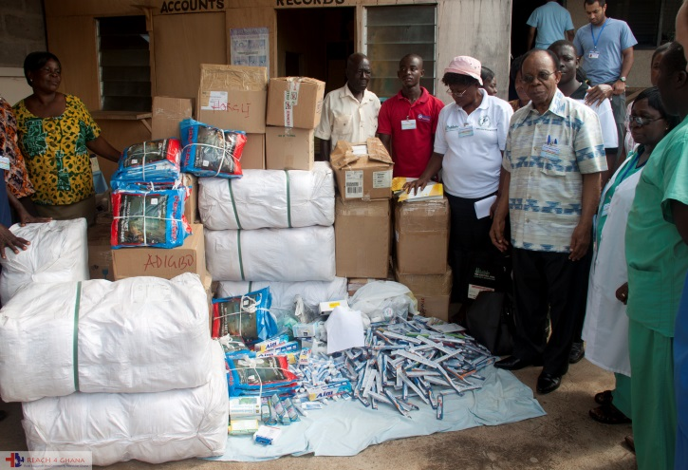
Prior Trips
Travel to Volta region of Ghana
Same 5 rural villages annually
Team operates out of Ho, district capital
2011: 14 M1s
2012: 10 M1s, 2 M2s, 1 PT
2013: 9 M1s, 1 M2, 5 PTs, 2 Pharm
2014: 11 M1s, 4 PTs, 2 Pharm
1000s of patients seen, treated, referred

Slide 22
Videos
2011 trip: https://www.youtube.com/watch?v=hAiyKVznLto
2012 trip: http://www.reach4ghana.org/2012-team.html

